Slide 1





The Gut-Mind Connection:
Cultivating Wellness From Within
Presented by Chelsea Kazmierczak-Goethel, MSACN, CNS

Slide 2



Hi! I’’m Chelsea
  Board Certified Functional Nutritionist
  Masters of Science in Applied Clinical Nutrition
  Functional Medicine Training through IFM & Foundational Medicine Training through Cellcore
  Advanced Clinically Trained in Nutrition Response Testing
  7 years of guiding people back to health and wellness through holistic, natural methods
  What brought me into the field? My own health journey...

Slide 3
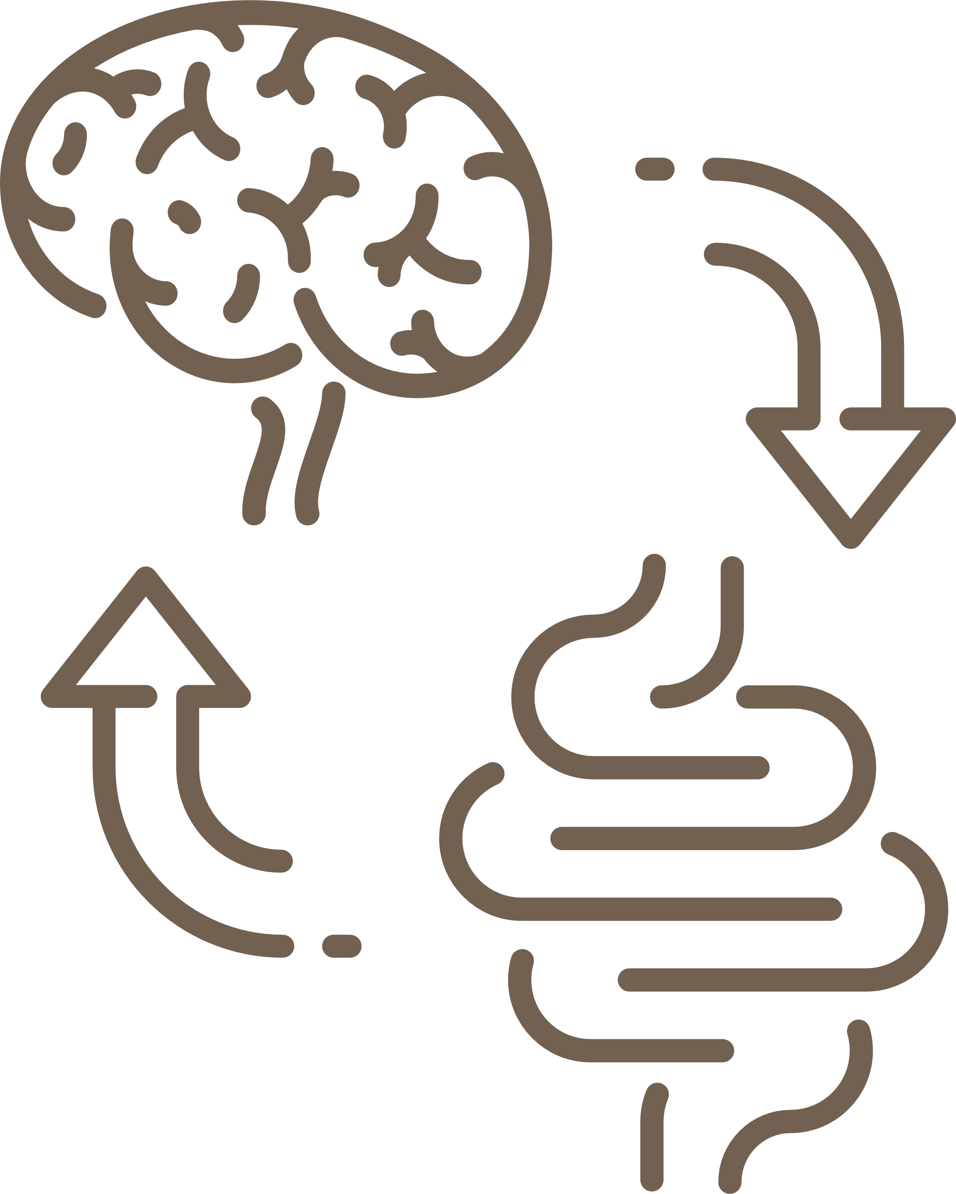
Overview
  Understanding the Foundations of the Gut-Brain Connection
  How the Gut Impacts Overall & Mental Health
  Lifestyle Factors Affecting the Gut-Brain Axis
  Practical Strategies for Improving Gut Health & Mental Well-being
**All information given in this presentation is for educational purposes, and should not be taken as medical advice. Please consult your healthcare provider who understands your health history for specific guidance on diet, supplements, etc.

Slide 4





Defining & Understanding the Gut Microbiota
Exploring the Enteric Nervous System (ENS)
Gut-Brain Connection: Foundations
Neurotransmitters & Signaling Pathways
Between the Gut
& the Brain
Gut-Brain Axis: Integrated Communication System

Slide 5

Defining & Understanding the Gut Microbiota
  Gut Microbiota/Microbiome = diverse community of microorganisms (bacteria, fungi, viruses, protozoa, parasites) living in the GI tract
  100 Trillion microbes, ~ 2-5 pounds of bugs
  Plays a crucial role in digestion, metabolism, immune function, mental health, cognition, cardiovascular health, the nervous system, inflammation, and hormones
  Diversity = the key to a resilient microbiome (300- 1,000 species)

Slide 6
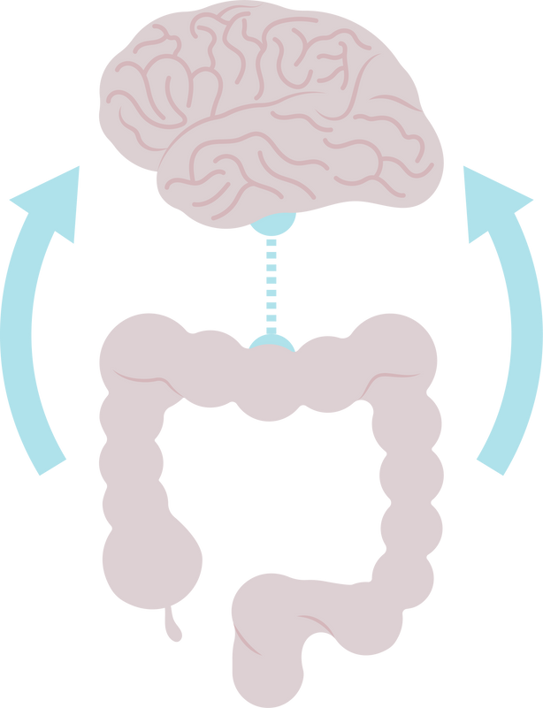
The Enteric Nervous System (ENS)
  The “Second Brain”
  A complex network of neurons embedded in the gut lining
  Part of the Autonomic Nervous System, along with the Sympathetic & Parasympathetic Nervous Systems
  Responsible for the bodies response to food/drink via breakdown & absorption of food, digestive secretions, blood flow, hormone release, gut motility
  Connects the brain & the gut via the Vagus Nerve
  “Gut Feelings” or “Butterflies in your Stomach”

Slide 7

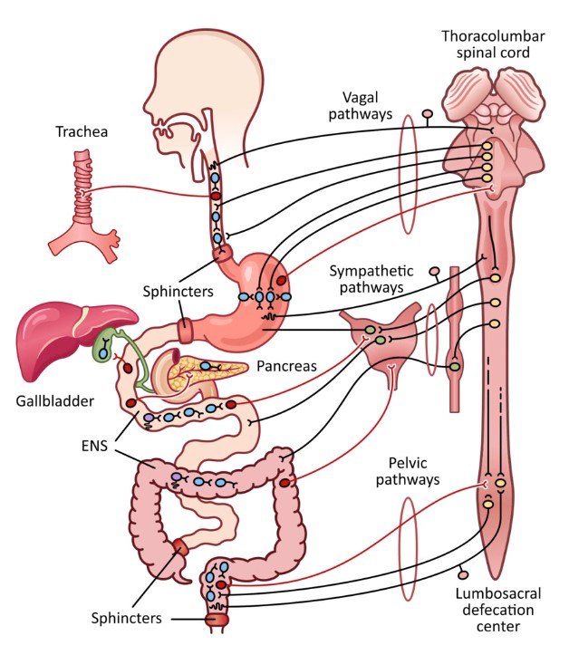

Slide 8

Neurotransmitters & Gut-Brain Signaling Pathways
  Produced in the gut, influence mood & behavior:
    Serotonin: satisfaction, happiness, sleep, digestion
    Dopamine: reward system, pleasure, motivation, memory
    GABA: calming, sleep, relaxation
  95% of serotonin receptors are in the gut, 95% of serotonin produced by the gut microbiome
  The health of the microbiome impacts neurotransmitter production, and brain function (emotions, cognition, stress response)

Slide 9
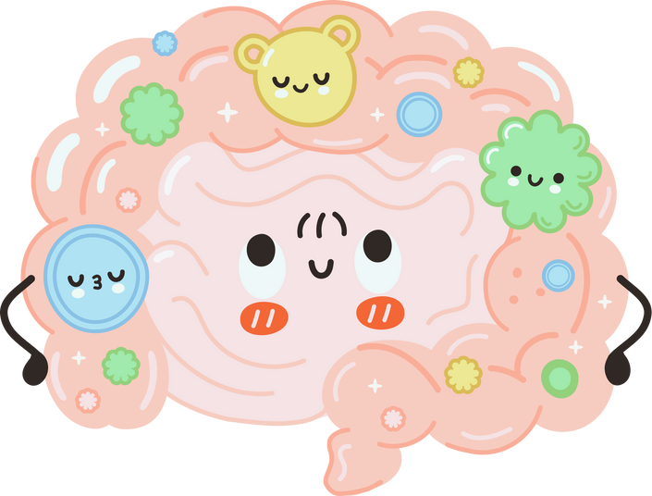
Gut-Brain Axis: Integrated Communication
  Bidirectional communication system linking the gut, ENS, CNS, and endocrine/hormonal system
  Plays a role in immune system, & metabolic communication
  Disruptions in this axis contribute to:
    Mental health disorders, emotional concerns, cognitive changes, neurodevelopment & degenerative diseases, digestive dysfunction, hormonal imbalance, immune system issues
  Correcting imbalances & inflammation in the gut shows great promise clinically & in research for management of mental health & cognitive concerns

Slide 10


Gut Impact on Mental Health
Gut-derived signals transmitted via the vagus nerve influence brain regions (and other organs/glands) involved in stress response and mood regulation (80/20)
Gut microbe imbalances (dysbiosis) are linked to mental health & neurodevelopment conditions (ADHD, ASD)
Imbalanced neurotransmitters (produced by the gut) can lead to anxiety, depression, and cognitive changes

Slide 11

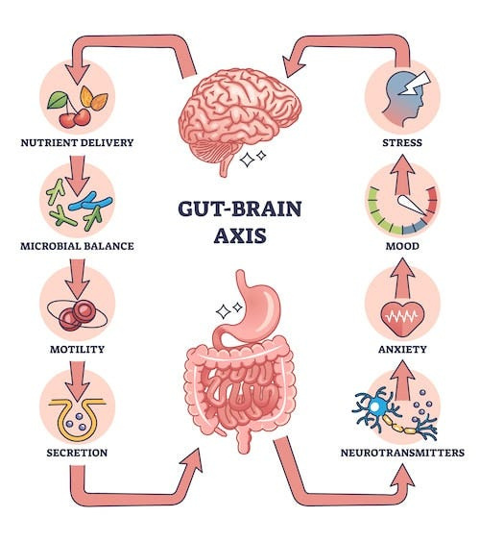


Slide 12

Gut Impact on Overall Health
Dysbiosis is linked to GI conditions: irritable bowel syndrome, IBD, and colon cancer
Gut-brain dysfunction impacts the HPA axis, and the entire hormonal system
Nutrient absorption, skin health, detoxification, and more are linked to the gut
A dys-regulated microbiome contributes to systemic inflammation and immune system activation (infx, autoimmune)
Gut health is linked to metabolic conditions (cardiovascular disease, diabetes, obesity)

Slide 13
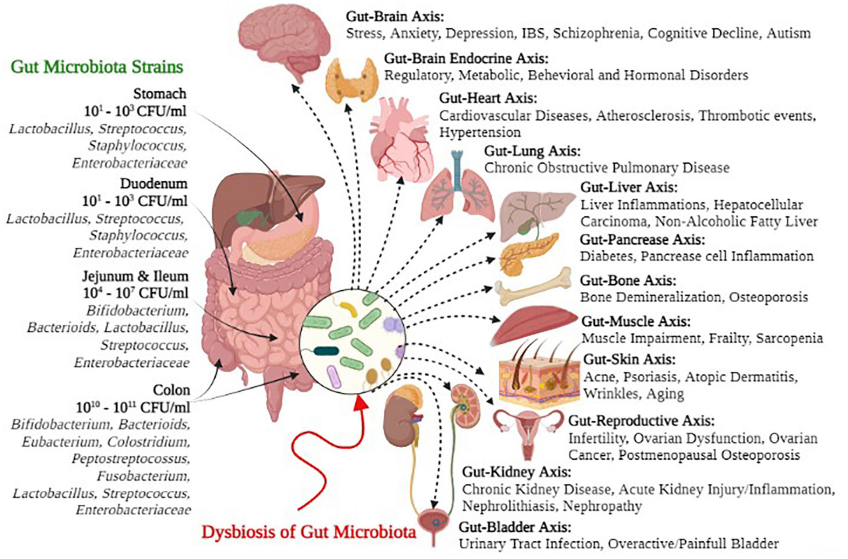

Slide 14
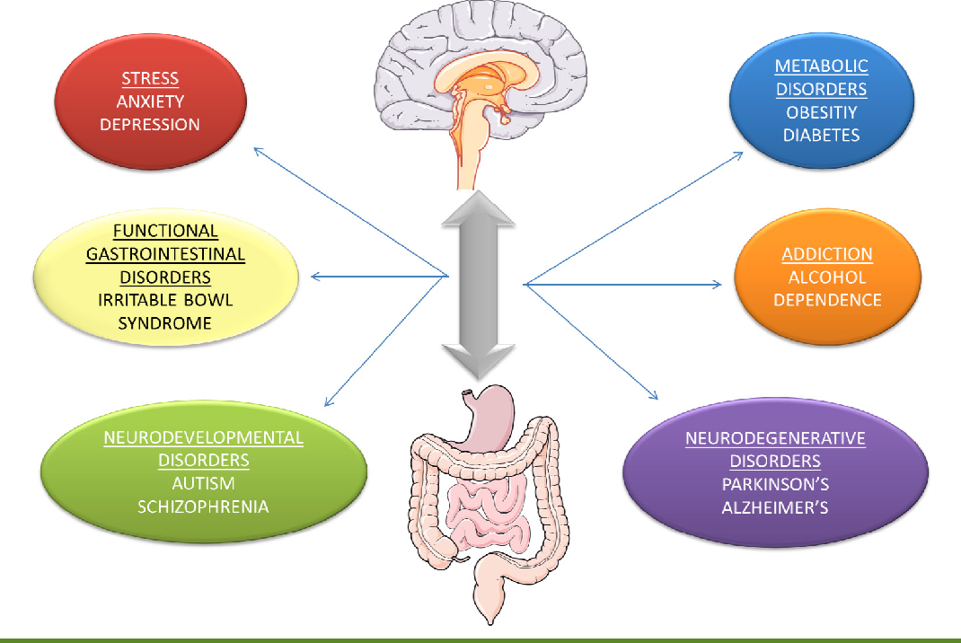

Slide 15

Factors Affecting the Gut-Brain Axis
Diet & Gut Health:
  A diverse & robust microbiome is the key to gut, brain, & overall health
  Microbiome & Nutrition:
    Diets with the widest diversity of foods foster a rich microbial environment
    Inflammatory foods (processed/refined foods, gluten, seed oils, alcohol, etc.) lead to decreased health and diversity in the gut
    Food additives (MSG, colors/dyes, HFCS, artificial sweeteners, etc.) can degrade the integrity of the microbiome
    Refined/processed sugar triggers inflammation and promotes microbiome dysfunction

Slide 16
Factors Affecting the Gut-Brain Axis
Macronutrients & Gut Health:
  *Eating variety & balance is key*
  Protein: balanced protein intake from animal and plant sources ferment in the gut and feed microbial species
  Carbohydrates: consuming a variety of complex carbs promote microbial diversity. Simple carbs & sugars in excess can contribute to inflammation of the gut & body
  Fiber & Resistant Starch: promote the growth of beneficial bacteria, provide bulk, and support detoxification
  Fats: excess consumption of trans & seeds oils can shift the microbiome into an unhealthy, inflammatory pattern

Slide 17
Factors Affecting the Gut-Brain Axis
Stress & The Gut: A Bidirectional Relationship:
  Stress impacts gut motility (speed), permeability, and microbial diversity via the autonomic nervous system & changes to neurotransmitters
  Stress activates the HPA axis, leading to the release of cortisol and adrenaline, impairing motility and increasing permeability & inflammation
  Chronic stress disrupts microbial composition, leading to dysbiosis
  Stress & emotions are felt, and stored, in the gut (think about “gut feelings”)

Slide 18
Factors Affecting the Gut-Brain Axis
Stress & The Gut: A Bidirectional Relationship:
  The vagus nerve transmits signals between the gut and the brain, influencing emotional and cognitive processes during times of stress
  Changes in neurotransmitter production caused by GI inflammation & immune system activation influence emotions and stress response
  Increased gut permeability decreased nutrient absorption, impacting our ability to produce proper neurotransmitters, exacerbating the stress response
  Impaired gut-brain communication contributes to the development and persistence of stress-related mental health disorders

Slide 19
Factors Affecting the Gut-Brain Axis
Sleep, Exercise, and Other Factors:
  Sleep quality & circadian rhythms impact the microbiome via the body clock and detoxification systems of the body
    Sleep disturbances and dysbiosis are closely linked
  Physical activity leads to beneficial changes in both microbial diversity of the gut, and mental health
  Alcohol, medications (antibiotics, PPIs, SSRIs), and smoking: all of these can impact gut permeability, the gut microbiome as well as mental health

Slide 20
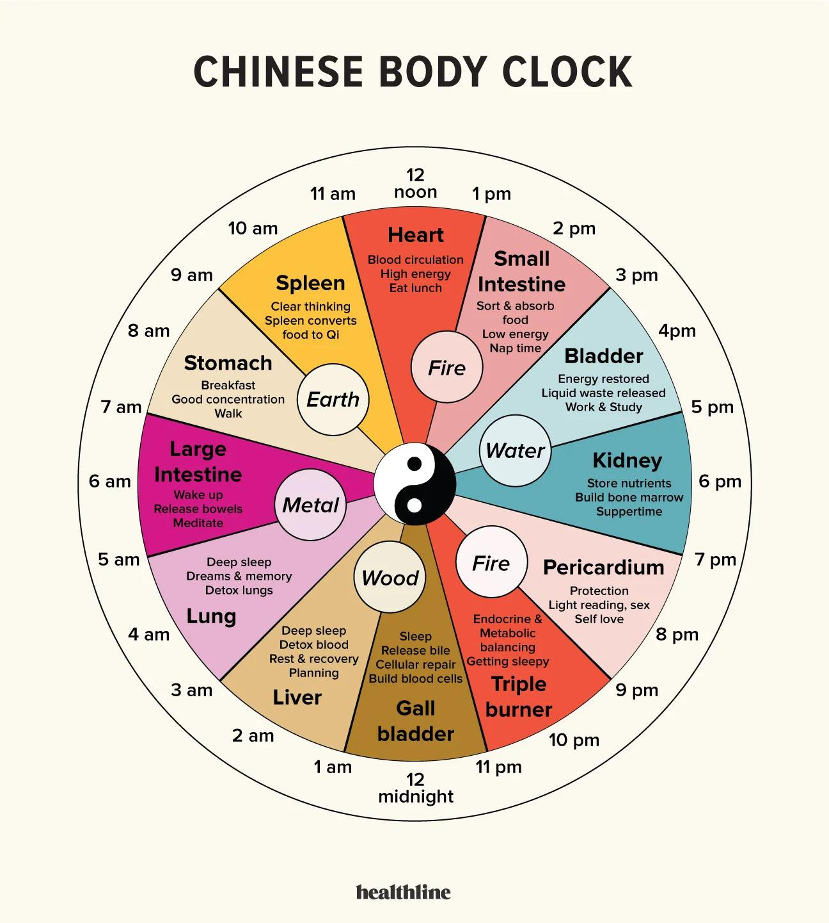

Slide 21
Factors Affecting the Gut-Brain Axis
Disruptions in Modern Lifestyles:
  Western Diet
    Diets high in processed foods/sugars lead to gut inflammation and imbalanced gut-brain communication
  Toxins and Environmental Factors
    Toxins in air, food, and water impact intestinal permeability, the microbiome, hormones, neurological health, & mental health
    Ex: heavy metals, pesticides, BPA, PFAs, pharmaceuticals, radioactive elements
  Screen Time and Technology
    Disrupted circadian rhythms, increased sedentary time, and increased stress levels from social media impact the gut, & the brain

Slide 22

Strategies for Improving Gut Health & Mental Wellbeing
Stress Management
Deep Breathing
Help restore balance to the nervous system
Coherence breathing (6 in, 6 out)
4-7-8 breathing
Diaphragmatic breathing
https://www.betterup.com/blog/parasympathetic-breathing-exercises
Mindfulness Meditations or Prayer
Journalling/Brain Dumping
Yoga, walking, or other calming activities
Time outside, grounding

Slide 23
Strategies for Improving Gut Health & Mental Wellbeing
Feeling & Healing
Support the Vagus Nerve
The body, especially the gut, keeps score
Allow yourself time to experience emotions vs. suppressing them
EFT (Tapping), Emotion Code
Work with a professional when appropriate
Stimulate communication between the gut and brain via the PSNS
Gargling, singing, Om-ing, humming, laughing
Allowing time to witness beauty around you
Cold water exposure (face, full body)

Slide 24
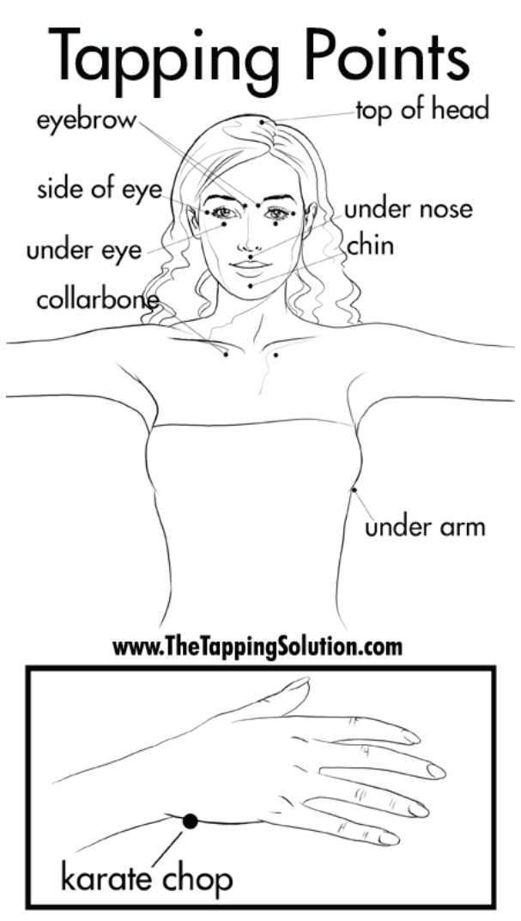
2
9
EFT For Gut & Mental Balance
3
5
4
6
7
Statement (get clear on what you’re experiencing):
“Even though I feel _____, I _____ (accept it, am okay/safe. give myself permission to relax)”
**Honor (don’t bypass) how you feel
Start the tapping while expressing how you are truly feeling now
As you start to feel better, then shift your statements to positive and uplifting statements
8
1

Slide 25

Strategies for Improving Gut Health & Mental Wellbeing
What You Eat
How You Eat
Sloowwwww down!
Create mindfulness around eating
Eat while seated
Deep breaths & gratitude/prayer before eating
Chew your food!
Listen/feel for hunger and fullness cues
There are so many “diets” out there- the perfect one for you is unique to you!
Identifying food sensitivities or trigger foods can be an important part of the gut-brain healing journey
*Seek the guidance of someone who can help you heal and eventually reintroduce foods

Slide 26
Strategies for Improving Gut Health & Mental Wellbeing
What You Eat
What You Eat
Replacing inflammatory foods:
Gluten, dairy, processed seed oils, processed sugars and grains, packaged foods
With:
Whole/less processed grains (quinoa, brown rice, oats, etc.), dairy alternatives, healthy fats, naturally sweet foods
Nourish the microbiome & neurotransmitters with:
Omega-3 Fatty Acids
Antioxidants (fruits, veg, green tea)
**Eat the rainbow
A variety of protein sources
Consider bone broth or tea for specific clinical benefits

Slide 27
Strategies for Improving Gut Health & Mental Wellbeing
Eat for Blood Sugar Balance
The “Biotics”
Prebiotics = foods that feed the good bugs (asparagus, bananas, onions, garlic, leaks, lentils/chickpeas, oats, chicory root)
Probiotics = the good bugs (“live” fermented foods: yogurt, kefir, sauerkraut, miso, sourdough)
Postbiotics = byproducts of bug activity (fermented foods, vit B12 & K, SCFA, peptides produced by the bugs)
Ideal eating order to balance blood glucose and stabilize your mood:
  Fiber containing foods
  Proteins + Fats
  Starchy foods
  Simple carbohydrates or sugars

Slide 28
Strategies for Improving Gut Health & Mental Wellbeing
Gut Environment Help
Hydration
Ample hydration with clean, filtered water (RO, distilled)
Start your day with 8-12 ounces of warm water, or lemon water, to wake up your microbiome & metabolism
*Limit black coffee on an empty stomach
Toxin reduction in your environment through filtering your water and air, using non-toxic products, and eating organic when possible supports a healthy gut and brain
Digestive bitters, enzymes, or apple cider vinegar with/before meals

Slide 29
Strategies for Improving Gut Health & Mental Wellbeing
Deeper Gut Work (with support!)
Other Supplements
Restoring gut health may require:
Mitochondrial Restoration
Detoxification & Drainage support
Anti-Parasitic Protocols
Mold/Mycotoxin Support
Neurotransmitter Support
With professional guidance, consider:
L-Glutamine
Pre/Pro/Post-Biotics
Collagen
Fiber (Psyllium, Chia seeds)
Anti-Inflammatories
Magnesium
Adaptogens

Slide 30
What are you adding, versus what are you giving up?
Choose 1 or 2 areas of focus
New Habits...
Habit stacking!
&
Habit tracking
Goal setting with genuine intention

Slide 31

Questions!?
Where you can find me for additional support, resources, & guidance:
www.KhailazWellness.com
Hello@KhailazWellness.com
IG: @Chelsea.Kaz.Goethel

Slide 32



Thank You So Much
Chelsea Kazmierczak-Goethel, MSACN, CNS, LN

